Slide 1
Looking At The Financial Aid Process

Slide 2
We’ll Discuss
Overview of Financial Aid
Financial Aid Terminology
FAFSA Overview
Next Steps
We’ll Help

Slide 3
Financial Aid Overview

Slide 4
Goal Of Financial Aid
The primary goal is to assist students in paying for
college and is achieved by:
Evaluating the family’s ability to pay educational costs.
Distributing limited resources in an equitable manner.
Provide a balance of:
Gift aid
grants & scholarships
Self-help aid
student employment & loans

Slide 5
Grants
Federal
Pell Grant ($767 to $7,395)
Supplemental Educational Opportunity Grant (SEOG) ($100 to $4,000)
TEACH Grant ($3,772)
State
21st Century Scholars
Frank O’Bannon Grant
Workforce Ready Grant
INvestEdIndiana.org/Grants

Slide 6
Credit Completion
Complete 30 credit hours each year to maintain maximum grant eligibility & graduate on time.
On Time
Full Time
30
Credits
15 Credits - Fall
15 Credits - Spring
24
Credits
12 Credits - Fall
12 Credits - Spring
48
Credits
12 Credits - Fall
12 Credits - Spring
60
Credits
15 Credits - Fall
15 Credits - Spring
72
Credits
12 Credits - Fall
12 Credits - Spring
90
Credits
15 Credits - Fall
15 Credits - Spring
96
Credits
12 Credits - Fall
12 Credits - Spring
120
Credits
15 Credits - Fall
15 Credits - Spring
120
Credits
12 Credits - Fall
12 Credits - Spring

Slide 7
Scholarships
Need based vs. Merit based
Where to look for scholarships:
FREE National Search Sites
College/University
Local/Community
School Counselor
Community Foundation
Business & Employer
Church & Civic Organizations
National
College / University
Local / Community
INvestEdIndiana.org/Scholarships

Slide 8
Scholarship Drawing
INvestEdIndiana.org/1000
Five
$1,000 Scholarships Awarded
Must be 16 or older to enter
INvestEdIndiana.org/1000

Slide 9
Student Employment
Benefits
Earn money to pay for college & minimize student loans
Job & interview experience
Build time management skills
Options
Federal Work-Study
Working Part-time
Internships

Slide 10
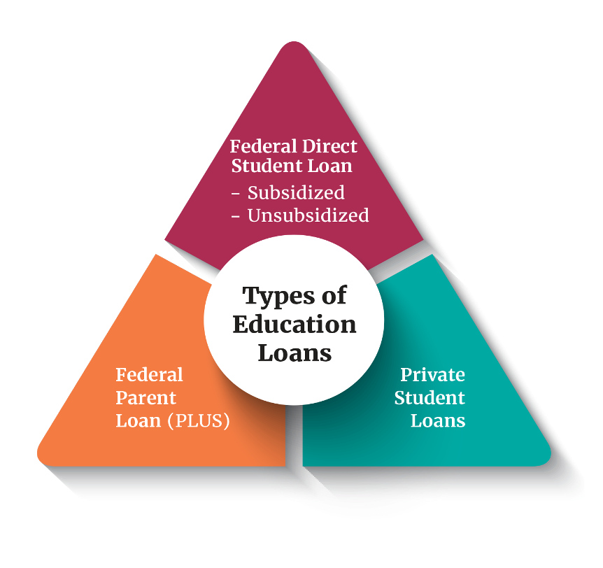
Education Loans
Federal Direct Loans
Student's Loans
Subsidized & Unsubsidized
Annual Limits
Federal Direct PLUS Loans
Parent's Loan
Eligibility impacted by adverse credit
Private Loans
Student and Cosigner's loan
Eligibility based on credit score & income
Rate: 5.50% & Fee: 1.057%
Rate: 8.05% & Fee: 4.228%
Rate: Varies & Fee: None

Slide 11
Financial Aid Terminology

Slide 12
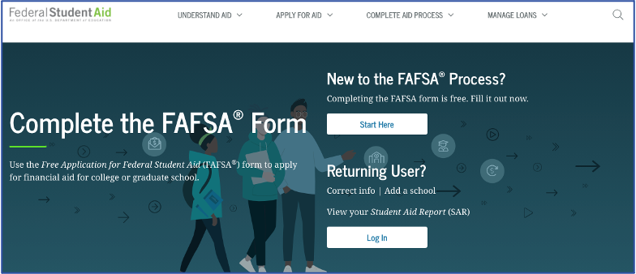
FAFSA
Free Application for Federal Student Aid
Annual application for most forms of financial aid
Basis for determining
Federal Funds
Grants
Work-Study
Loans
State of Indiana Grants
Some institutional funds
Calculates student aid index
studentaid.gov

Slide 13
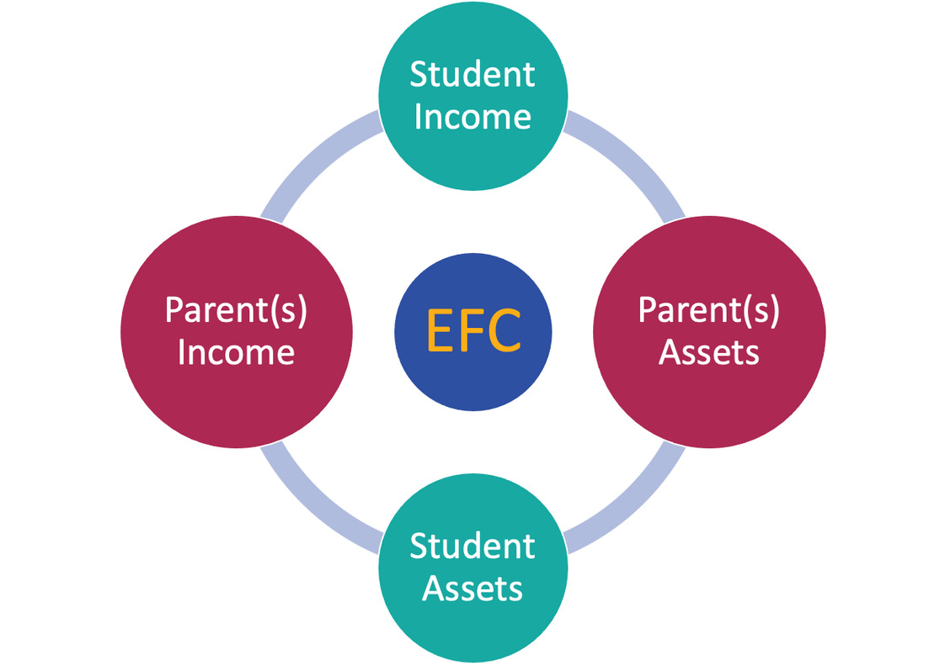
Student Aid Index
FAFSA calculation
Based on income, assets, & family data
Used by the college to calculate your financial aid offer
SAI
INvestEdIndiana.org/FAFSA

Slide 14
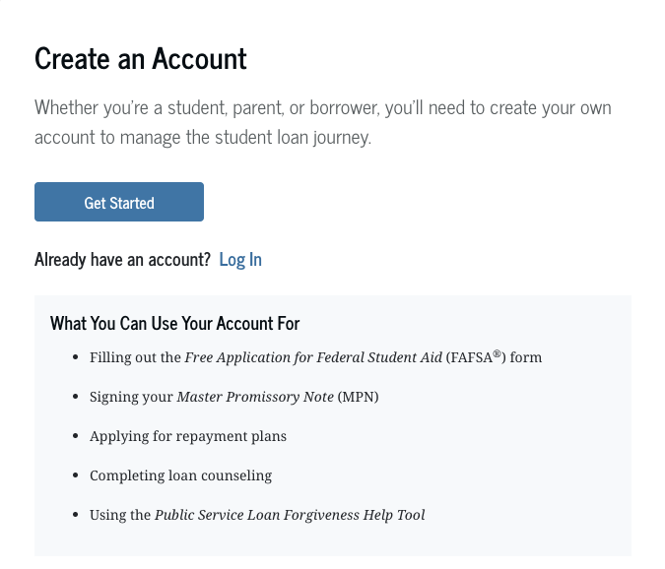
Federal Student Aid Account (FSA ID)
User account unique to each person
Student uses to login to FAFSA & sign electronically
Contributors (parent, parent’s spouse, student’s spouse) use to sign electronically
Notes when creating account
Student & contributors can NOT use the same email or phone number
Required to link email and/or phone number to account
Will require a two-step verification & will provide a backup code
Need help creating your FSA ID?
INvestEdIndiana.org/FAFSA

Slide 15
FAFSA Overview

Slide 16
FAFSA
Expected to open in December
Uses completed tax data
Know deadlines
State of Indiana priority deadline - April 15th
Colleges - Ask them

Slide 17
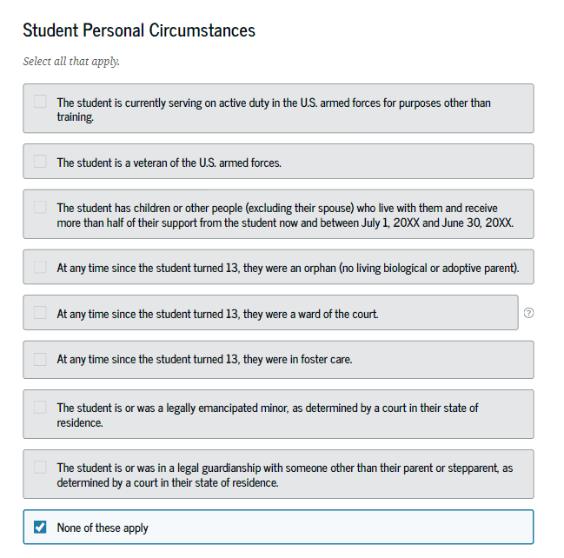
Personal Circumstances
Determined from:
Born before January 1, 2001
Graduate/professional student
Student marital status
Student dependents
At risk of being homeless
Additional situations

Slide 18
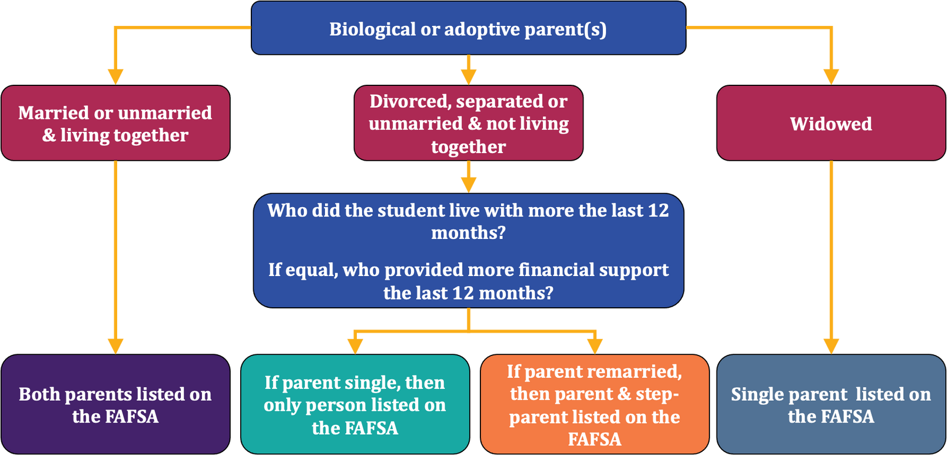
Who Is The Contributor (Parent)?
Who provided the most financial support in the last 12 months?

Slide 19
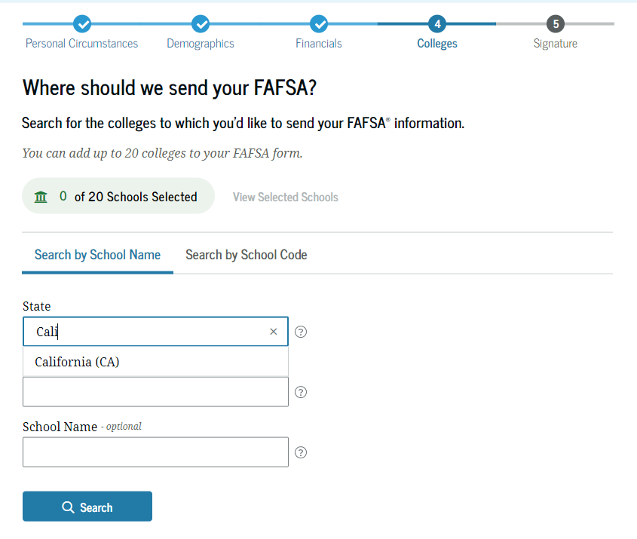
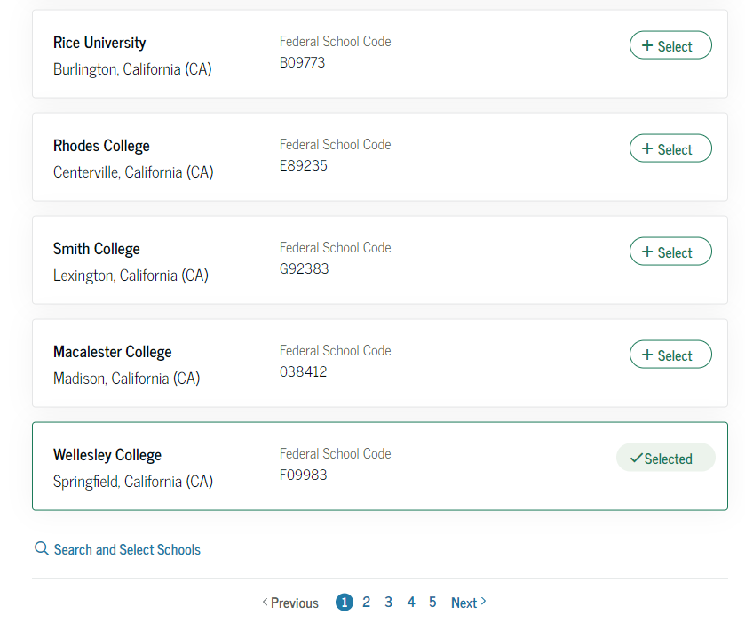
School Selection
Select colleges you want to receive your FAFSA information
List up to 20 colleges
Encouraged to list at least 1 college from Indiana
Can always update schools
Can enter by Federal School Code or by name/location

Slide 20
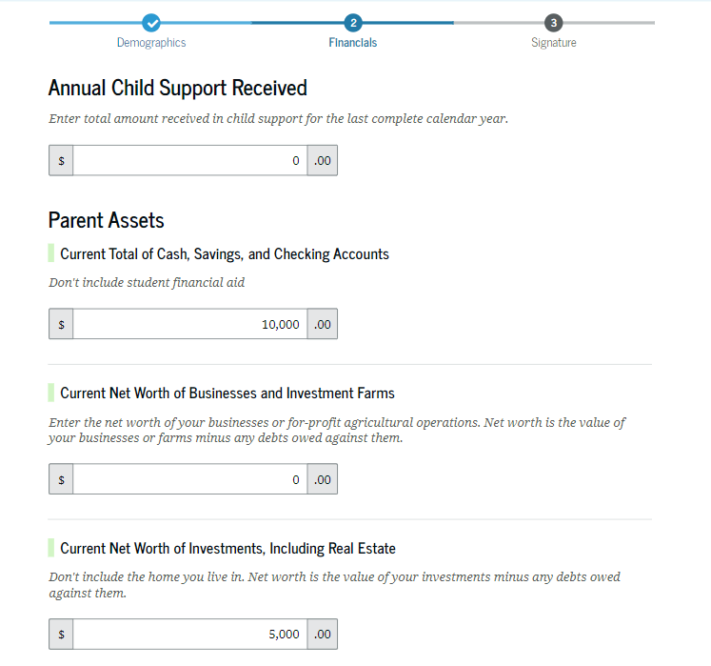
Asset Information
Assets do NOT include the values of:
The home you live in
Retirement plans
Value of life insurance
Assets DO include the values of:
Cash, savings, and checking
Real estate, stocks, bonds, 529 college savings plans, and other investments
Business or family farm
Child support received (prior year)

Slide 21
Skipping Information
If offered the opportunity to skip remaining income and/or asset questions
Yes
Allows you to move on
No
Allows you to submit information but won’t impact your calculation

Slide 22
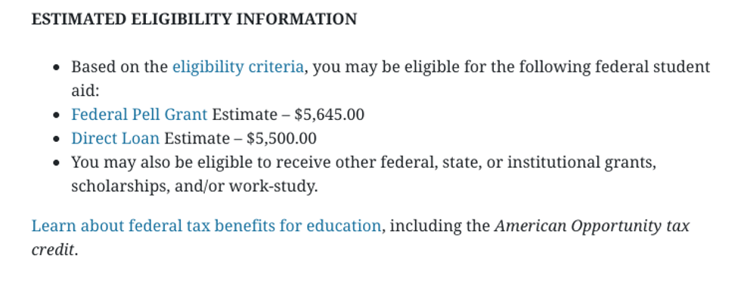
Confirmation Page - SAI
Key elements:
SAI
Estimated Pell - if eligible
Direct Student Loan
All other aid determined by the college’s Financial Aid Office

Slide 23
Next Steps

Slide 24
Special Circumstances
Changes to your situation not represented on the FAFSA may include:
Change in employment or income status
Medical expenses not covered by insurance
Change in parent marital status
Unusual dependent care expenses
Student unable to obtain parent information
If a special circumstance occurs, contact the college’s Financial Aid Office

Slide 25
Financial Aid Offer
Timing & delivery of offer varies by college
Size of school
When FAFSA was submitted
Each college provides a financial aid offer outlining the following:
Cost of attendance
Financial aid amounts (Grants, scholarships, work-study, & loans)
Options to pay remaining balance
What you should do:
Review costs and financial aid offers
Clearly understand your obligations
Ask questions

Slide 26
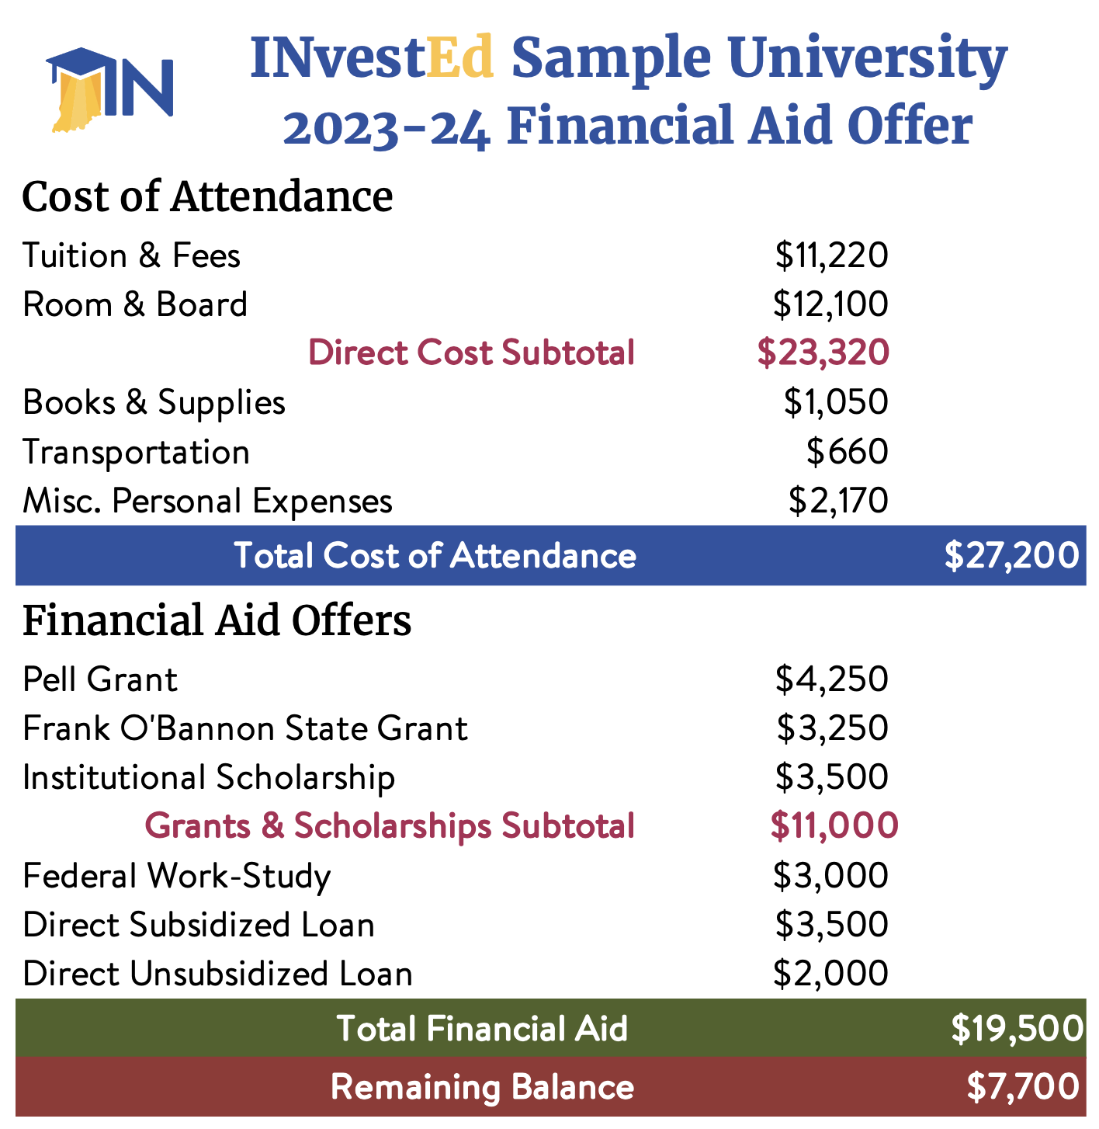
Sample Financial Aid Offer
Typical Sections:
Cost
Grants & Scholarships
Work Study
Student Loans
Remaining Balance
Outside Scholarships
Out of Pocket
Payment Plan
PLUS (Parent) Loan
Private Loan

Slide 27
We’ll Help!

Slide 28
College Goal Sunday
Free FAFSA help from financial aid professionals
Sunday, February 25, 2024
Time: 2:00pm (Local Time)
For more information:
CollegeGoalSunday.org

Slide 29
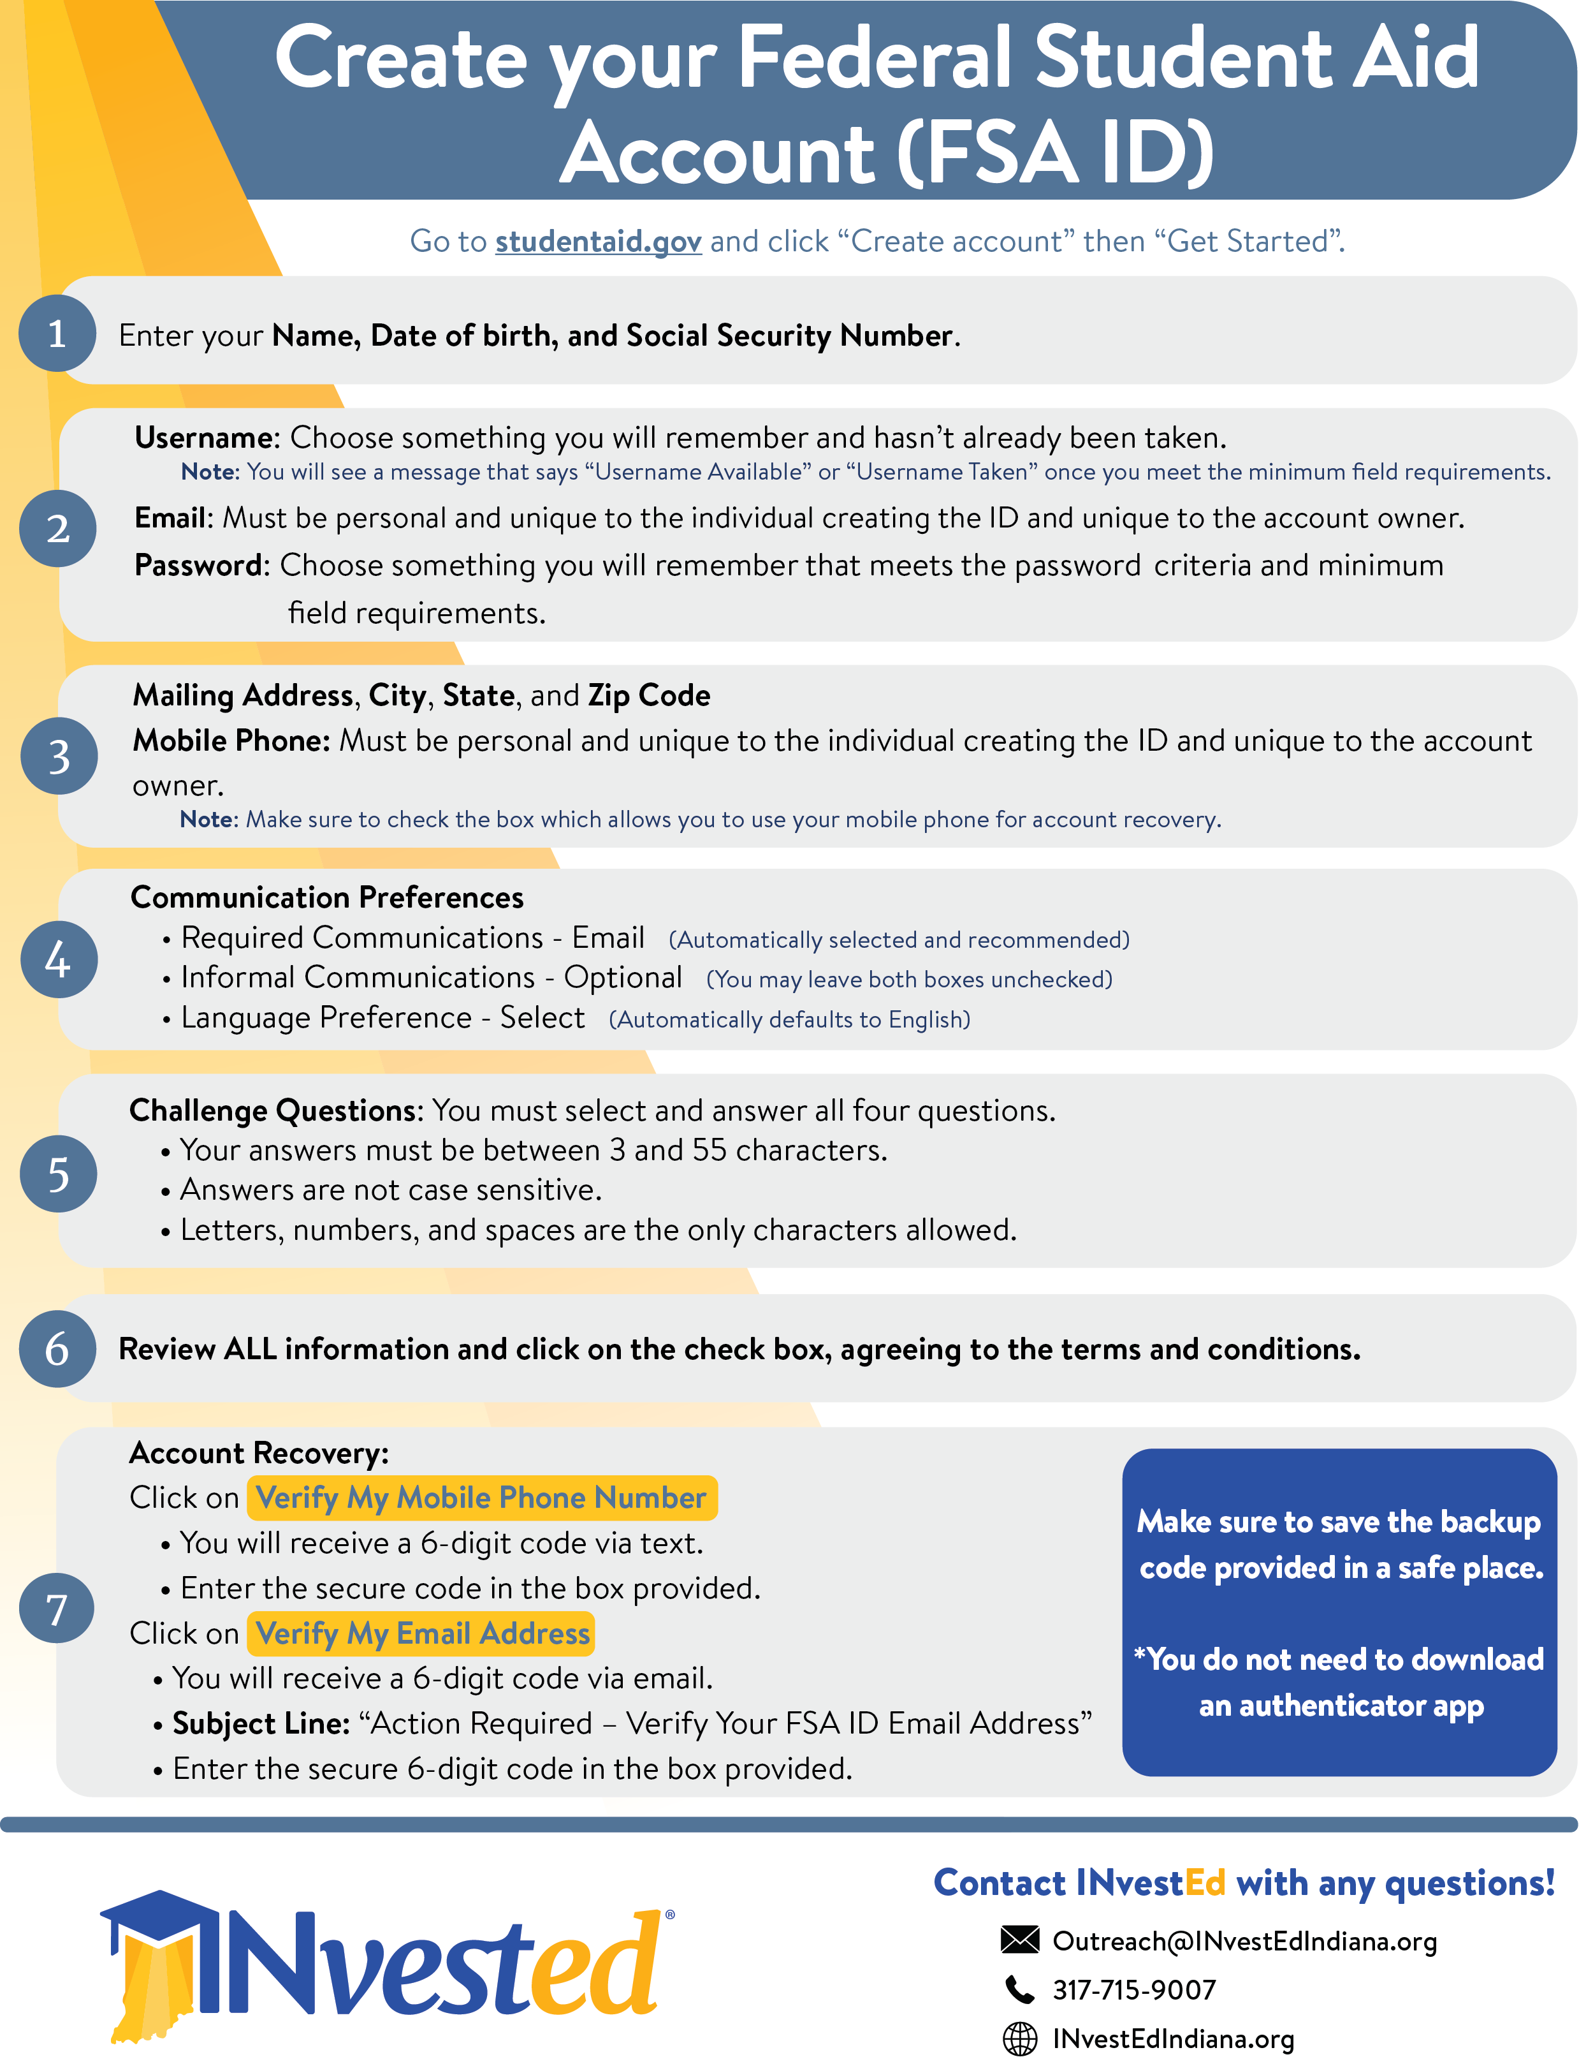
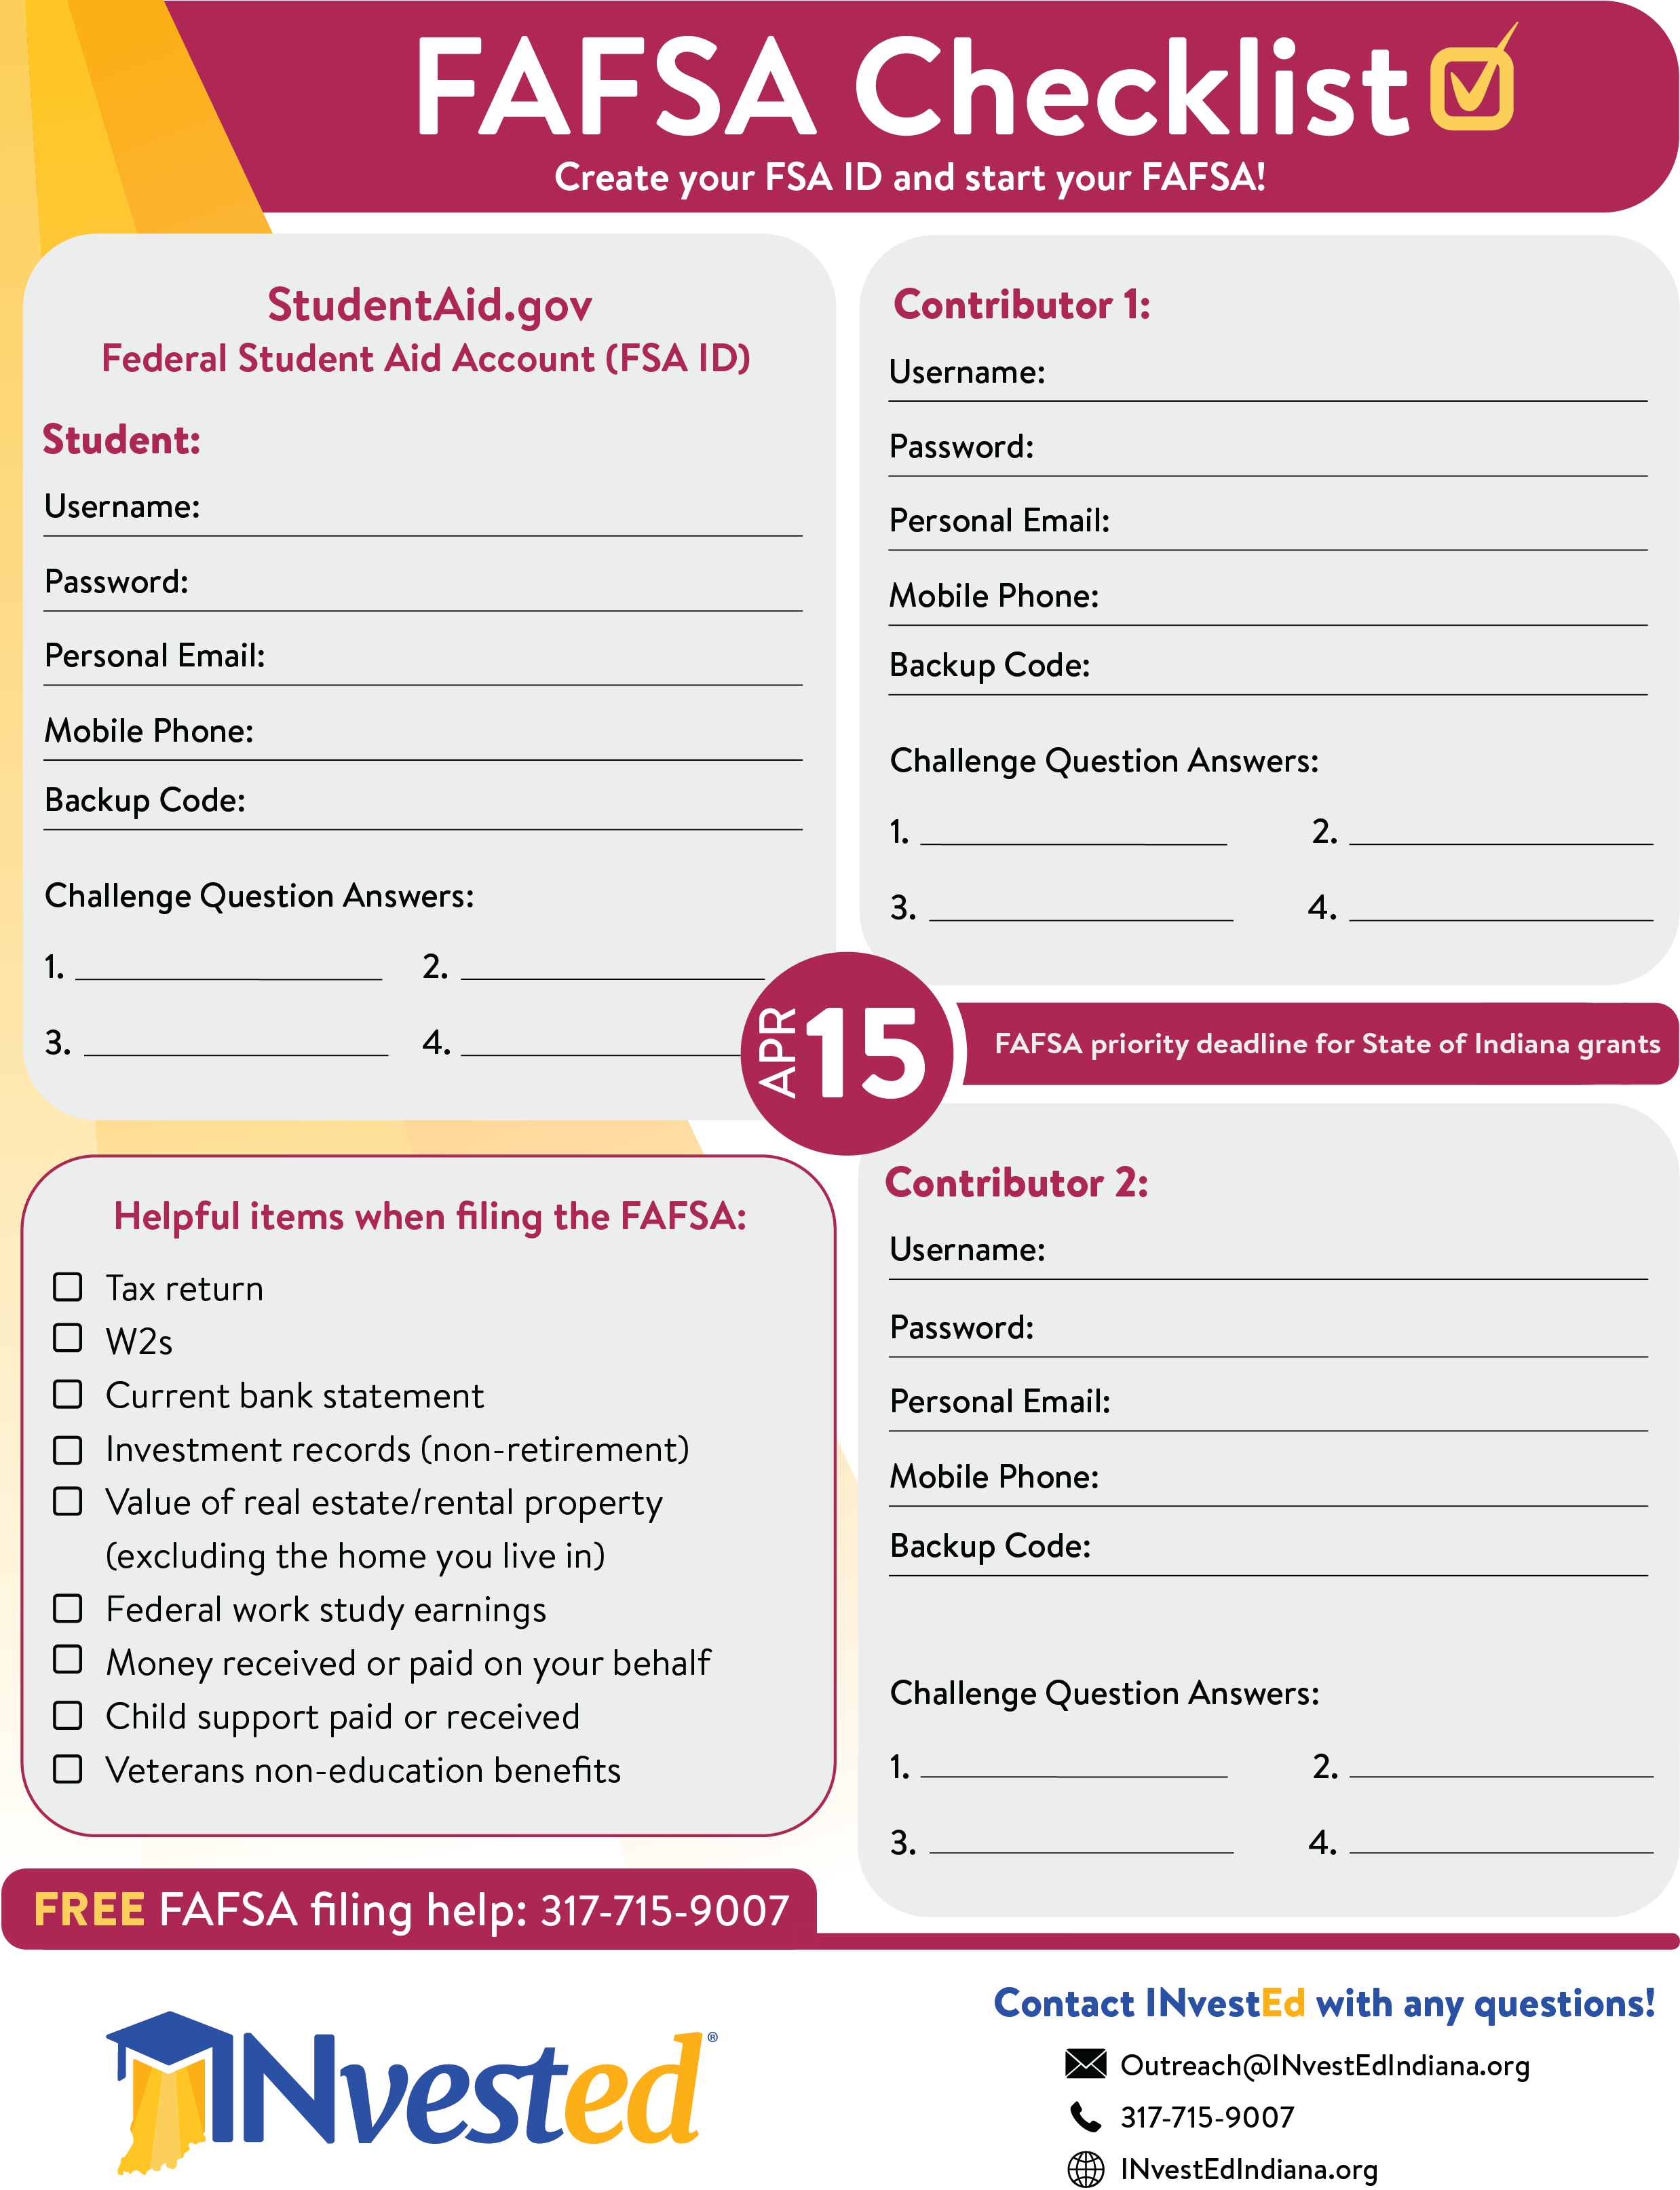
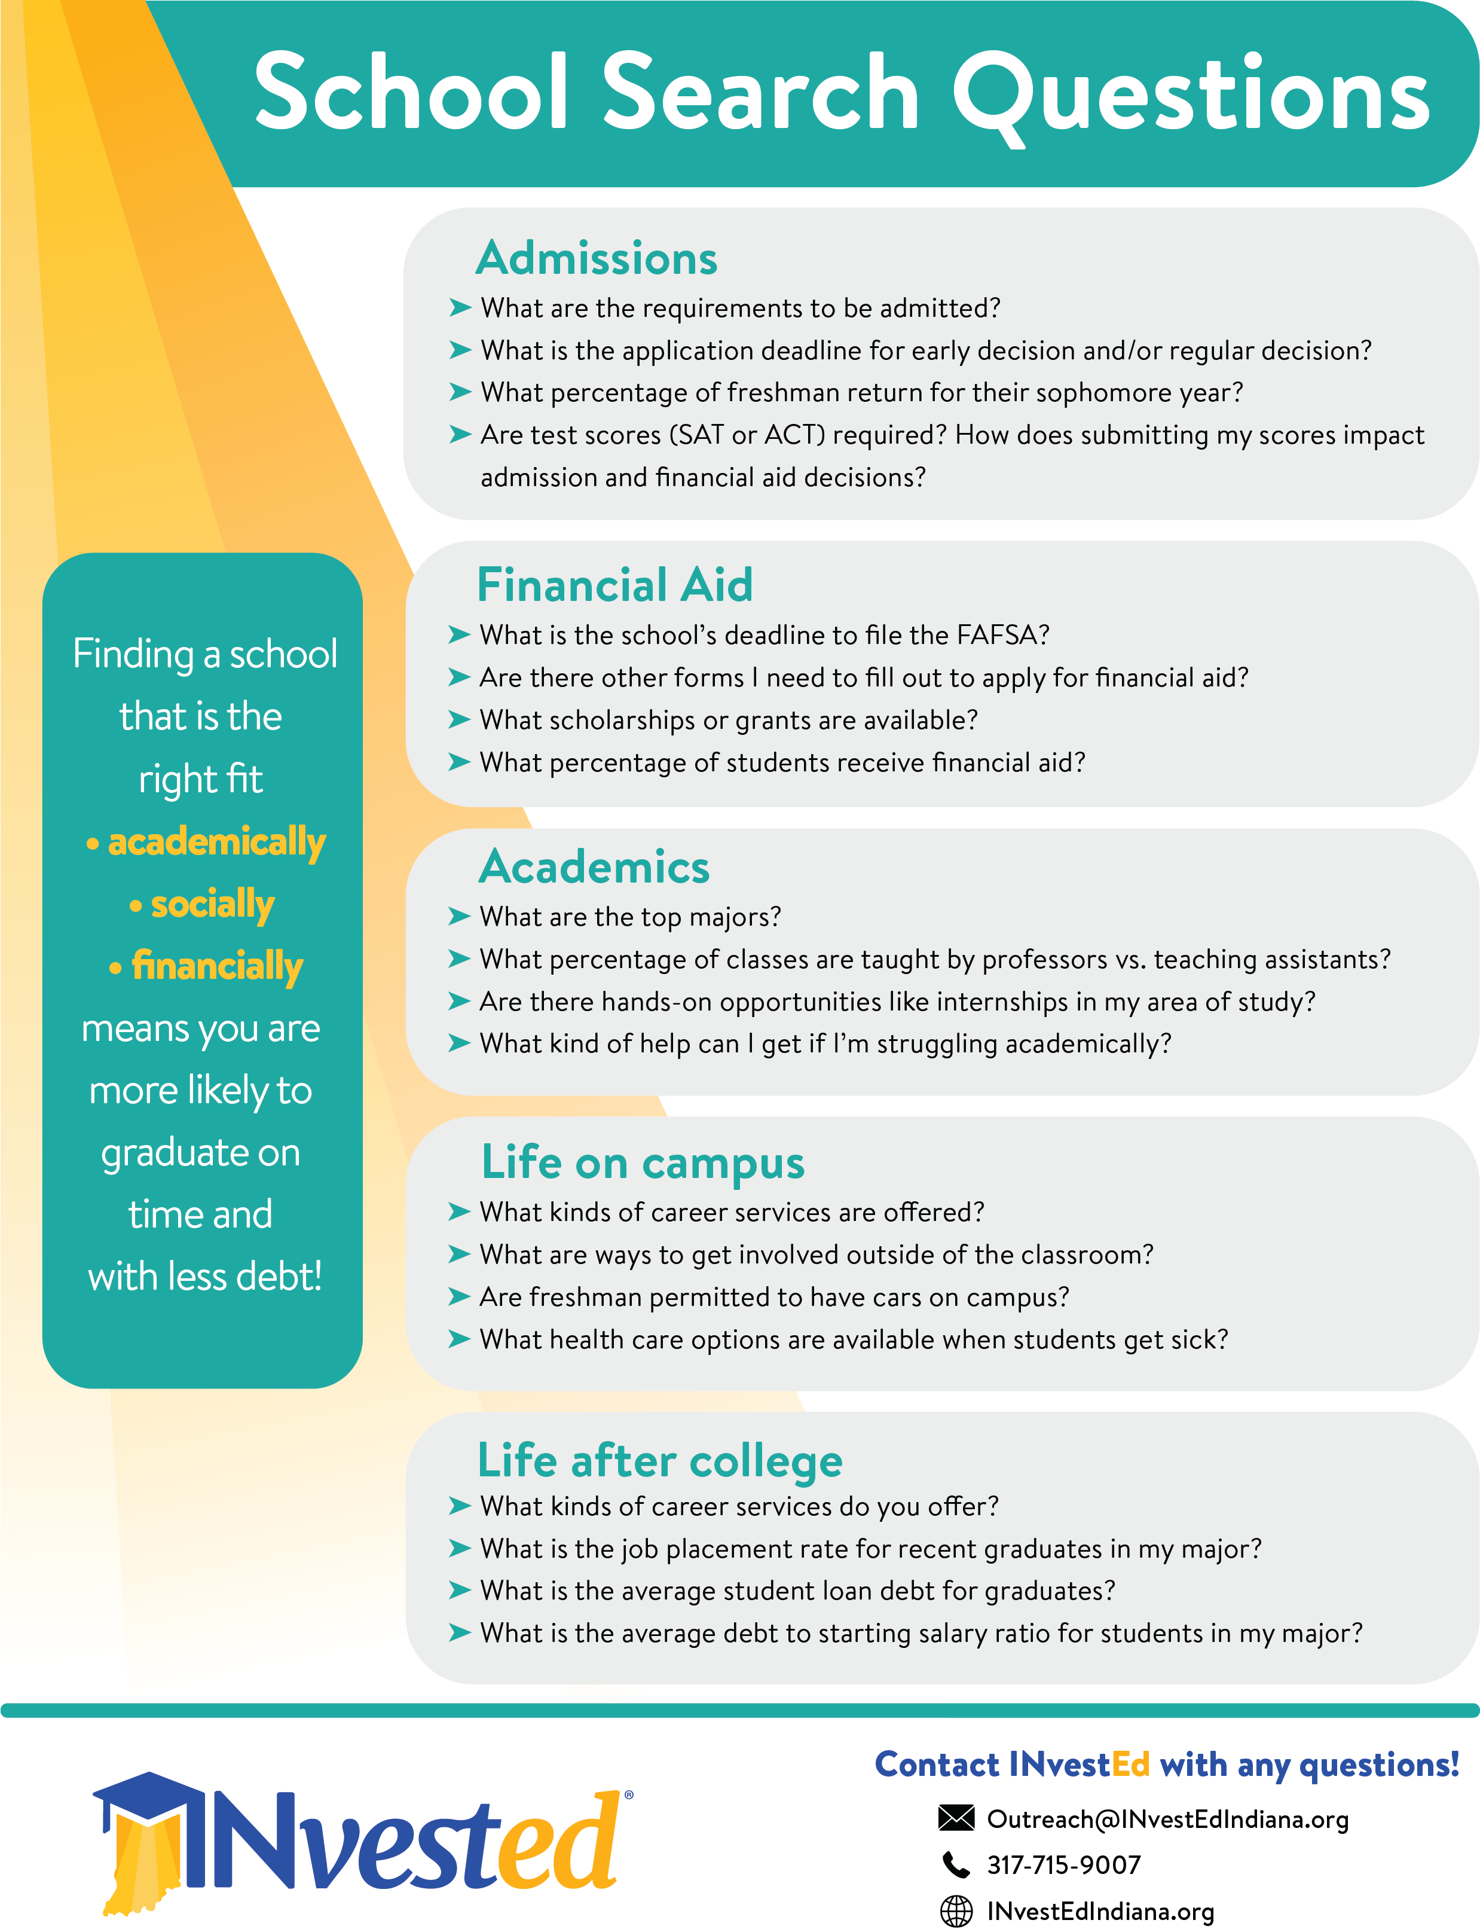
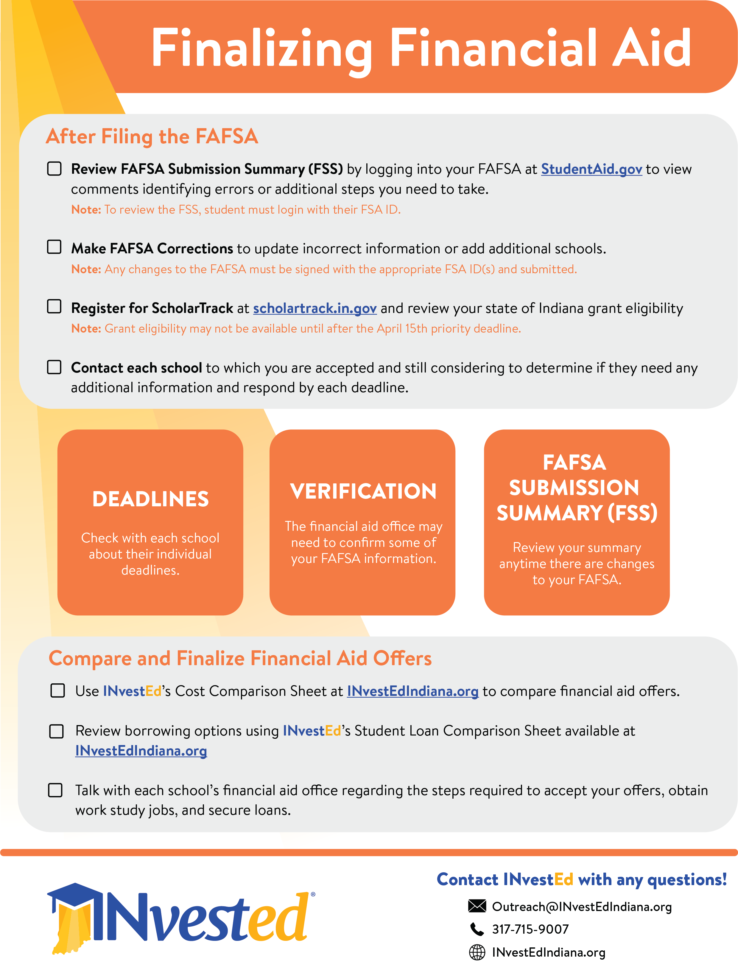
INvestEdIndiana.org

Slide 30
@INvestEdIndiana

Slide 31
Stay Connected With Us:
317.715.9007
Outreach@INvestEdIndiana.org
Join our mailing list:
INvestEdIndiana.org/mailing-list

